Slide 1
Chapter 3- RFID Aplications
Dr. Vinayak Ashok Bharadi

Slide 2
Content
Introduction - Concepts and technology: RFID, transponder, RFID architecture
Hardware, Hardware issues
RFID Protocols: Pure ALOHA, slotted ALOHA, frame slotted ALOHA, tree protocols, tree splitting algorithms, binary search algorithms, bitwise arbitration protocols. Main query tree protocols.
RFID applications i.e. logistics and supply chain, production, monitoring and maintenance, product safety, quality and information, access control and tracking and tracing of individuals, payment, loyalty, household etc.

Slide 3
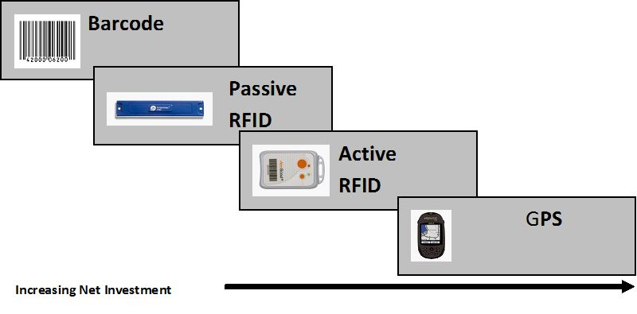
Nesting diagram

Slide 4
RFID
Radio-frequency identification (RFID) uses electromagnetic fields to automatically identify and track tags attached to objects.
An RFID tag consists of a tiny radio transponder; a radio receiver and transmitter. When triggered by an electromagnetic interrogation pulse from a nearby RFID reader device, the tag transmits digital data, usually an identifying inventory number, back to the reader.

Slide 5
Applications
Tag Serial number can be used to inventory goods.
There are two types. Passive tags are powered by energy from the RFID reader's interrogating radio waves.
Active tags are powered by a battery and thus can be read at a greater range from the RFID reader; up to hundreds of meters.
Unlike a barcode, the tag doesn't need to be within the line of sight of the reader, so it may be embedded in the tracked object. RFID is one method of automatic identification and data capture (AIDC).

Slide 6
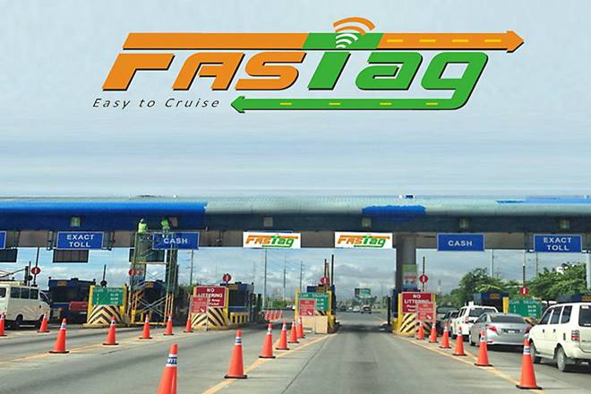
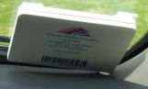
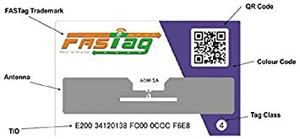
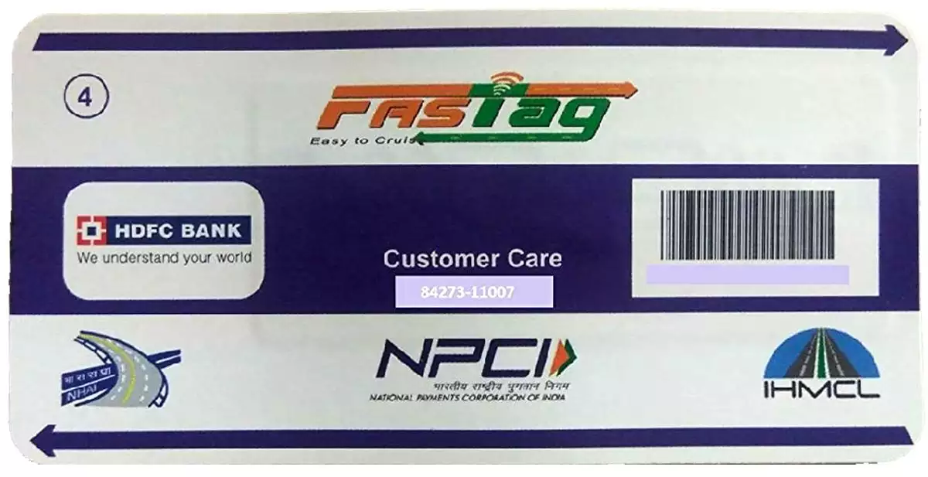


Slide 7
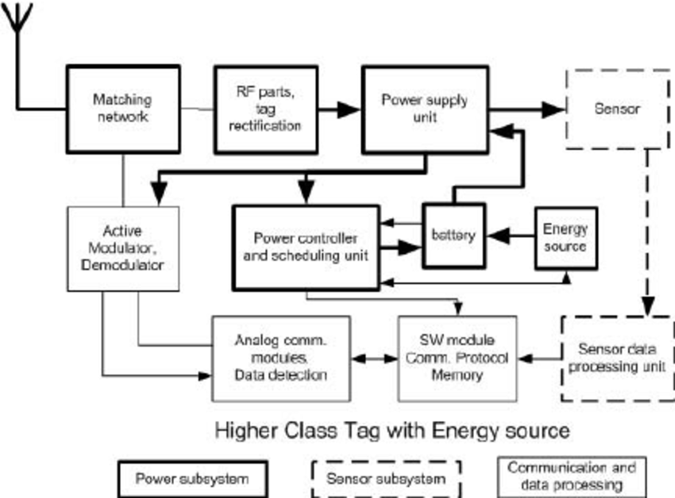
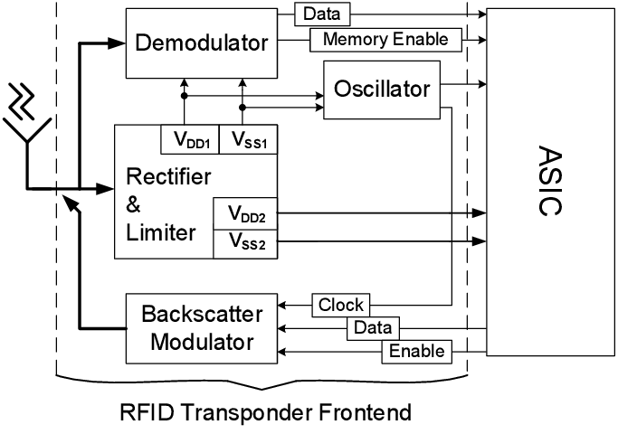
RFID Transponder

Slide 8
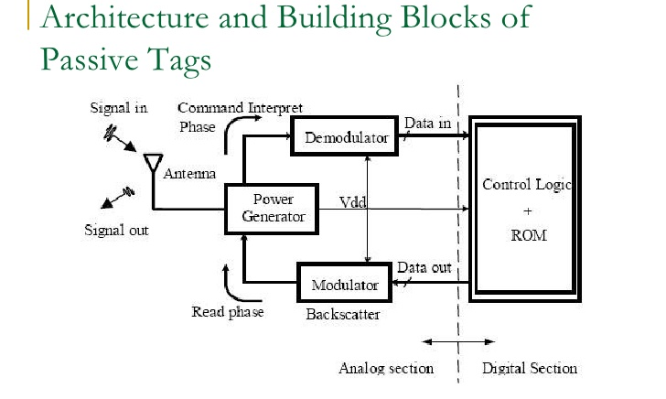

Slide 9
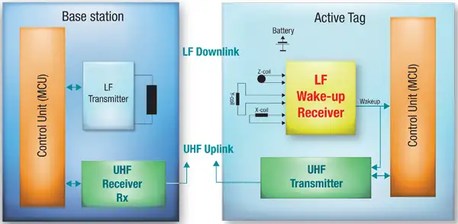

Slide 10
Passive and Active Tag
A passive tag uses the electromagnetic energy it receives from an interrogator’s transmission to reply to the interrogator. The reply signal from a passive tag, which is also known as the backscattered signal, has only a fraction of the power of the interrogator’s signal. This limited power significantly restricts the operating range of the tag. Since passive tags are low power devices, they can only support data processing of limited complexity. On the other hand, passive tags typically are cheaper, smaller, and lighter than other types of tags, which are compelling advantages for many RFID applications.
An active tag relies on an internal battery for power. The battery is used to communicate to the interrogator, to power on-board circuitry, and to perform other functions. Active tags can communicate over greater distance than other types of tags, but they have a finite battery life and are generally larger and more expensive. Since these tags have internal power, they can respond to lower power signals than passive tags.

Slide 11
A semi-active tag is an active tag that remains dormant until it receives a signal from the interrogator to wake up. The tag can then use its battery to communicate with the interrogator. Like active tags, semi- active tags can communicate over a longer distance than passive tags. Their main advantage relative to active tags is that they have a longer battery life. The waking process, however, sometimes causes an unacceptable time delay when tags pass interrogators very quickly or when many tags need to be read within a very short period of time.
A semi-passive tag is a passive tag that uses a battery to power on-board circuitry, but not to produce return signals. When the battery is used to power a sensor, they are often called sensor tags. They typically are smaller and cheaper than active tags, but have greater functionality than passive tags because more power is available for other purposes. Some literature uses the terms “semi-passive” and “semi- active” interchangeably.

Slide 12
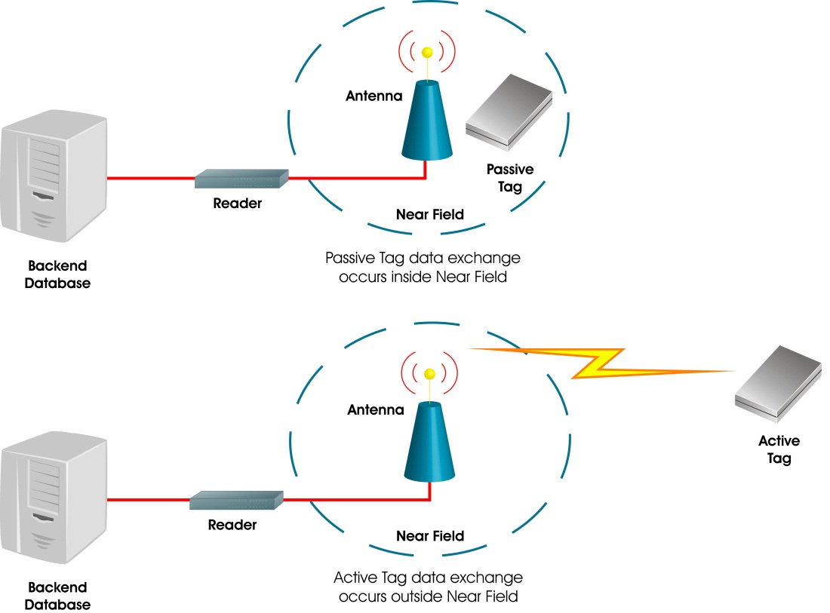

Slide 13
Carrier Frequencies
Today, there are four carrier frequencies implemented for RFID that are popular globally: 125 KHz, 13.56 MHz,
UHF ranging from 866 to 950 MHz depending on national radio regulations,
Microwave frequencies of 2.45 GHz and 5.8 GHz. There is also the frequency range 430-440 MHz, which is allocated to amateur radio usage around the world.
The ISM band 433.05-434.790 MHz is located near the middle of the amateur radio band. The amateur radio band has emerged as an RFID channel in a number of applications. The frequency range has been called the ‘optimal frequency for global use of Active RFID’.

Slide 14
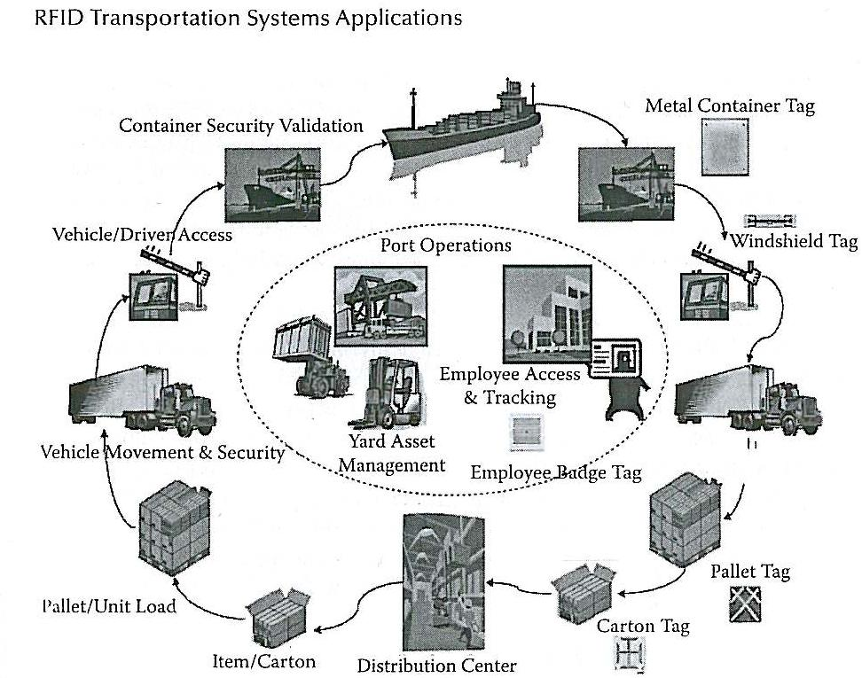
RFID in SCM

Slide 15
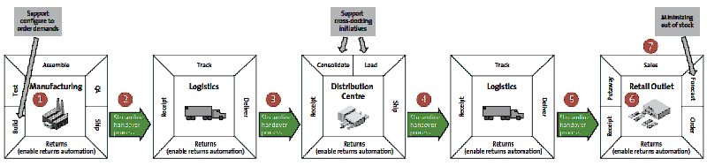
Supply chain containing RFID technology

Slide 16
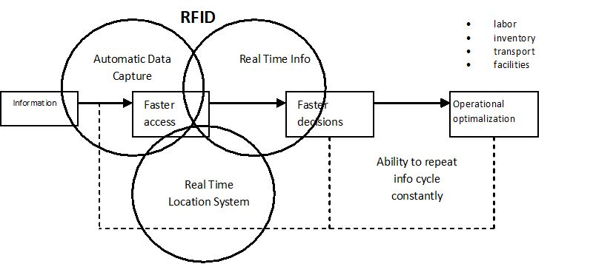
RFID-enabling technology

Slide 17
RFID Protocols

Slide 18
reference
https://www.intechopen.com/books/radio-frequency-identification-from-system-to-applications/possibility-of-rfid-in-conditions-of-postal-operators

